Slide 1
There is No Time to Prepare Like the Present: Disaster Preparedness, Response & Recovery 101
PRESENTED BY:
KAREN HAGAN, APD EMERGENCY COORDINATING OFFICER
MICHAEL TAYLOR, APD REGIONAL OPERATIONS MANAGER, SUNCOAST
Ron DeSantis, Governor
Taylor Hatch, Director

Slide 2
Disasters Affect Everyone
Children
Elderly
Individuals with disabilities
Caregivers
All socio-economic statuses
EVERYONE!

Slide 3
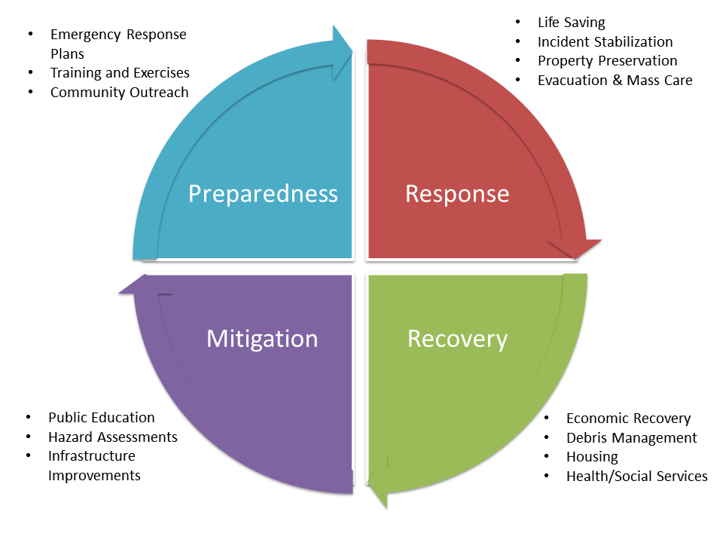
Emergency Management

Slide 4
Preparedness… Be Disaster Ready
Develop an Emergency Disaster Plan
For You and Your Family
For Those You Care For
Communicate your plan to family,
friends, and caregivers
Update your plan annually!
Planning Resources
www.floridadisaster.org/planprepare/
https://www.ready.gov/plan-form
https://www.floridadisaster.org/globalassets/family-communication-plan-1.pdf
APD Personal Disaster Plan https://apd.myflorida.com/

Slide 5
Preparedness cont.
Discuss these 4 questions with your family and those you care for to start your/their emergency plan:
How will we/they receive emergency alerts and warnings?
What is my/their shelter plan? How will we/they get there?
What is my/their evacuation route?
What is my/their family communication plan?
Make sure your/their plans meet your/their specific daily living needs and responsibilities
Create your/their own personal network for the areas where you/they need assistance
https://resourcedirectory.apd.myflorida.com/resourcedirectory/
Build a Disaster Supply Kit
Know your/their community resources

Slide 6
Disaster Supply Kit https://www.floridadisaster.org/globalassets/plan--prepare/disaster-supply-checklist.pdf
Water: for drinking, cooking, and sanitation. Pack a minimum of one gallon per person per day for 3-7 days. Food: a minimum of 3-7 days per person per day: Non-perishable packaged or canned food and juices Manual can opener Foods for individuals with dietary restrictions (e.g., infants, elderly) Snack foods Cooking tools and fuel Paper plates and plastic utensils | Pillows, blankets, and/or sleeping bags Clothing – change of clothes, including sturdy shoes to protect from debris or other sharp objects First aid kit, prescription medication, and other medicines Radio - battery operated and/or NOAA weather radio Flashlight and batteries Toiletries

Slide 7
Disaster Supply Kit, cont.
Cleaning supplies Special items Cash Important documents – store critical documents in a waterproof container and save them electronically. Insurance and medical records including medication information Bank account numbers Social Security card, etc. | Toys, books, and games Pet/service animal care items: Proper identification Immunization records Ample supply of food and water Carrier or kennel Medication(s) Muzzle and/or leash Photo of yourself and your pet(s)

Slide 9
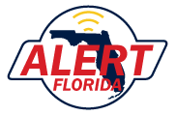
Emergency Alerts and Apps
www.Redcross.org/apps
Red Cross First Aid App
What to do if emergency help is delayed
Emergency App
Weather alerts
Open Red Cross shelter locations
Safety steps for different emergencies
English or Spanish
https://apps.floridadisaster.org/alertflorida/
Receive emergency alerts and other public safety notifications in your community

Slide 10
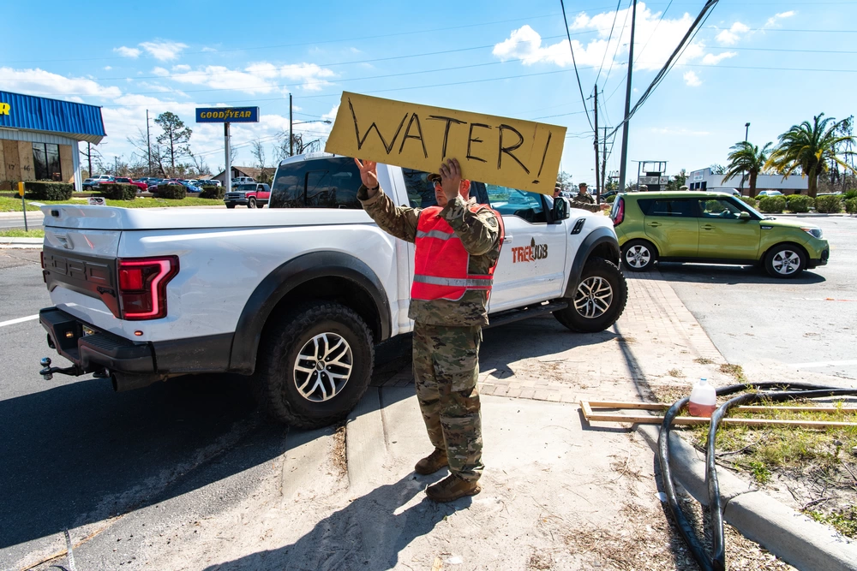
Recovery
Bulk distribution: Points of Distribution (PODs)
Debris collection
Individual assistance programs (I.A.): state and federal
Coordinated county, state, and federal resources
Family Resource Centers
Support (FRSCs)
Disaster Recovery Centers
(DRCs)
Unmet Needs/Long-Term
Recovery committees

Slide 11
Mitigation
Education
Flood zones
Informed decisions on where you live and your type of home
Know Your Zone (Evacuation)
Know Your Home (Secure)
Community rebuilding
Resiliency
https://www.floridadisaster.org/planprepare/
know-your-zone-know-your-home/

Slide 12
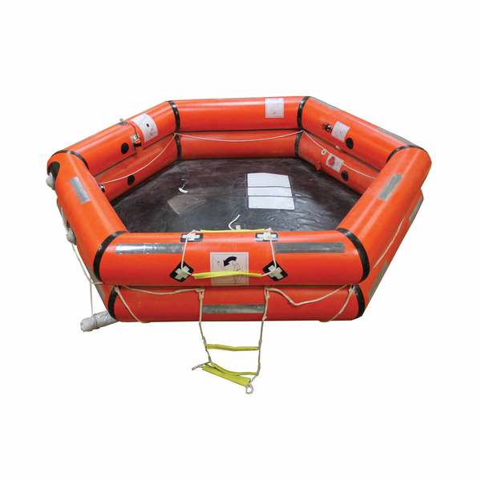
Sheltering: General Population Shelters
A shelter is a life raft!
Access/functional needs
Generally, 10-20 square feet per person
Basic first aid/volunteers
Hurricane Ian – 256 shelters – 33,178 people
www.floridadisaster.org/planprepare/shelters/
www.FloridaDisaster.org/counties

Slide 13
Sheltering: Special Needs Shelters
This should not be the first option
Special Needs Registry: Requires registration annually
https://snr.flhealthresponse.com
Capacity varies by county
Medically fragile / electrically dependent
Oxygen dependent
Generator power, including refrigerators
40-60 square feet per person
Caregivers usually are necessary
63 Special Needs Shelters opened for Hurricane Ian (over 4,000 individuals and 48 service animals sheltered)
45 Special Needs Shelters opened in 38 counties for Hurricane Idalia (598 individuals sheltered, 1,137 staff, and 166 caregivers)

Slide 14
Sheltering Alternatives
Shelter in place when NOT in an evacuation zone
Know Your Zone – Know Your Home https://www.floridadisaster.org/planprepare/know-your-zone-know-your-home/
Plan to shelter with friends or family
Group homes - use of host home approach preferred
Combines resources
Improves level of supervision/response
Better environment
Place of service flexibility
Hotel / Motel out of affected area

Slide 15
Evacuation Issues
Time - upwards of 20 hours to leave the state
Gas – shortages and high prices
Road rage
Service limitations
Lack of hotel space leads to overuse of shelters
Follow your plan. Know where you are going.
Leave early!

Slide 16
Explaining the Unexplainable: Helping Children/Others Understand Emergencies
A Child/Other’s Situation
Aware of what is going on
Disruption of life as they know it
Feel helpless, stressed, and in disarray
Loss of routine and comfort
Need a safe space
People “sleeping” in their school
Everyone around them is stressed
What Can We Do?
Let them help in recovery
Let them talk, or process through play and art
Validate their feelings
Don’t pretend everything is OK
Provide safe, kid/other-friendly, low-tech activities
Love them through it!

Slide 17
Roles of APD
> Follow the APD Comprehensive Emergency Management Plan (CEMP) + Defines concept of operations and Mission essential functions + Identifies Incident Management Team + Alternative locations: Continuity of Operations Plan (COOP) + Designated 24/7 representation at the State Emergency Operations Center (SEOC)
> Communicate essential information to consumers, providers, Waiver Support Coordinators (WSCs), and staff https://apd.myflorida.com/news/toolkit.htm
> Utilize the Everbridge Emergency Notification System
> Manage flexibilities throughout the emergency
> Work with partner agencies
> Problem solve throughout the disaster cycle

Slide 18
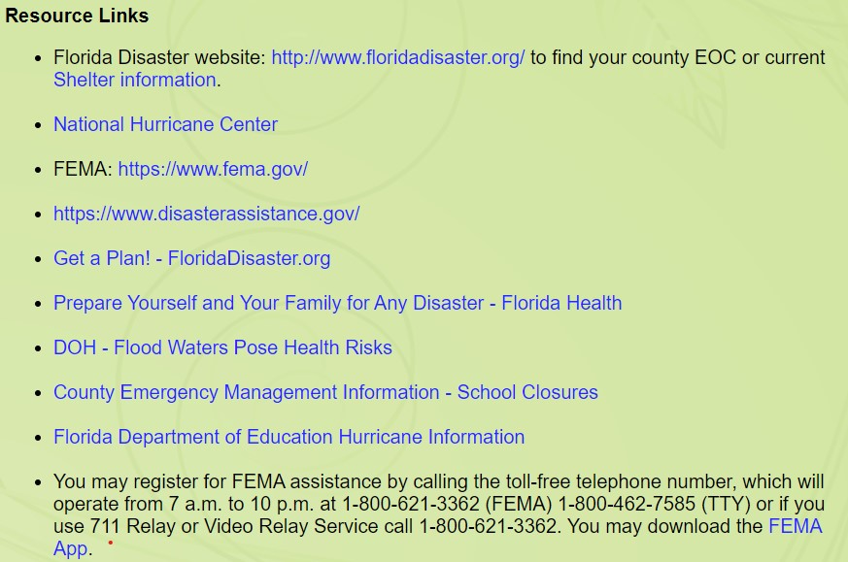
Disaster Preparedness and Recovery Resources
https://apd.myflorida.com/news/toolkit.htm

Slide 19
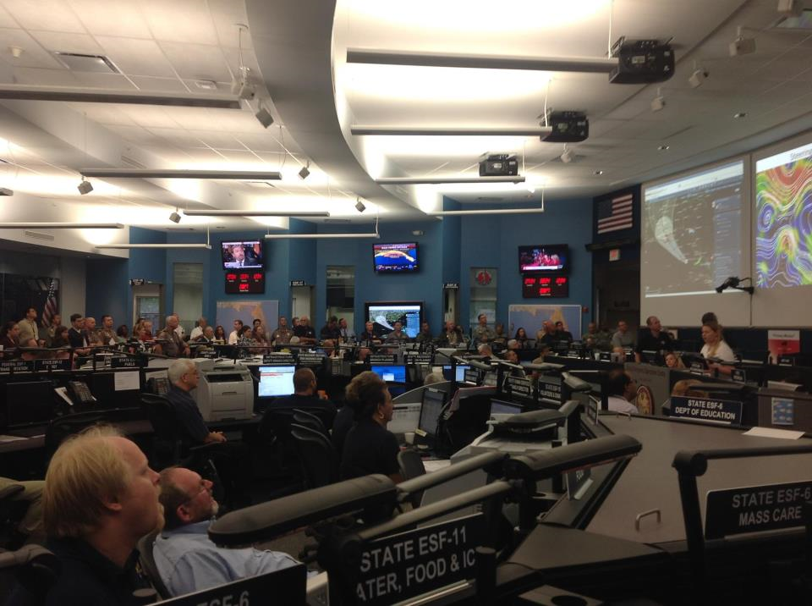
Information is Key to Effective Decision-making!!
Gather high level of information and problem solve throughout the disaster cycle
Communicate essential information to:
WSCs and providers
Licensed group homes
Supported living
Family home
APD-operated facilities

Slide 20
Disaster Planning is Essential
A disaster plan is a living document
EVERYONE needs a disaster plan!
Be sure those tasked with a role in your plan are aware and remain available.
Your disaster plan should include:
How to meet your communication needs
What your evacuation and shelter plans are
How to meet your transportation needs
Update and practice your disaster plan annually.
We’re in this together!
Notes:
Information overload at times.
Easy to dismiss/complacent
Revise, Revise, Revise – update condition, supports, resources
Irma – should help with good plans this year
Many templates aside from FDDC handout.
Main Resource: ready.gov; fema.gov; floridadisaster.org
Drive to find weak spots in plan

Slide 21
Thank You
Karen Hagan, APD ECO
(850) 412-0085
Karen.Hagan@apdcares.org
Michael Taylor
APD Regional Operations Manager, Suncoast
(813) 293-7232
Michael.Taylor@apdcares.org
For additional information about APD, please call the State Office at 1-866-APD-CARES (1-866-273-2273) or visit our website at www.apdcares.org.

